Slide 1
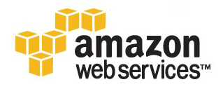
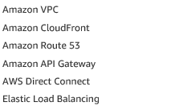
Networking & Content Delivery

Slide 2
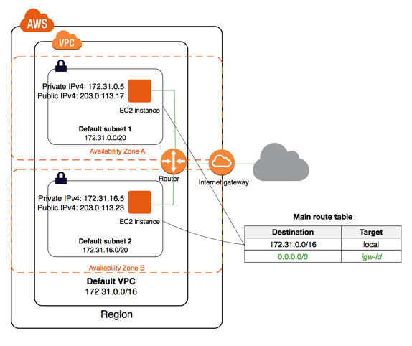
Virtual Private Cloud

Slide 3
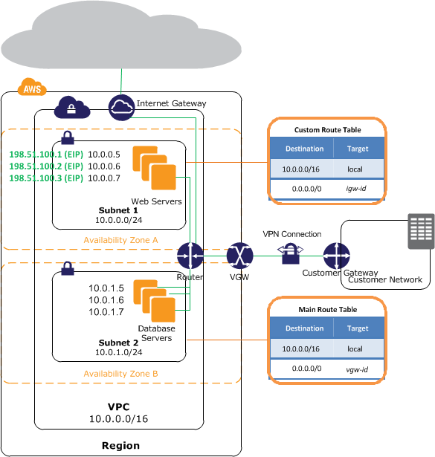
Virtual Private Cloud

Slide 4
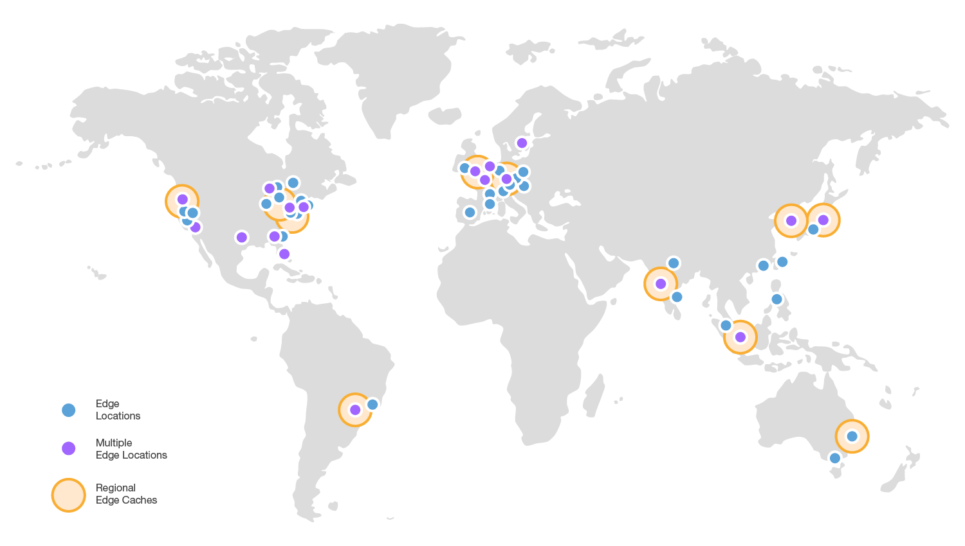
Amazon CloudFront
Notes:
Highly programmable, secure content delivery network (CDN)
Amazon CloudFront is a global content delivery network (CDN) service that securely delivers data, videos, applications, and APIs to your viewers with low latency and high transfer speeds. CloudFront is integrated with AWS – including physical locations that are directly connected to the AWS global infrastructure, as well as software that works seamlessly with services including AWS Shield for DDoS mitigation, Amazon S3, Elastic Load Balancing or Amazon EC2 as origins for your applications, and Lambda@Edge to run custom code close to your viewers.
You can get started with CloudFront in minutes, using the same AWS tools that you're already familiar with: APIs, AWS Management Console, AWS CloudFormation, CLIs, and SDKs. CloudFront offers a simple, pay-as-you-go pricing model with no upfront fees or required long-term contracts, and support for CloudFront is included in your existing AWS Support subscription.

Slide 5




Amazon CloudFront
Global, Growing Content Delivery Network
Secure Content at the Edge
High Performance
Cost Effective
Notes:
The Amazon CloudFront content delivery network is built on the expanding global AWS infrastructure that currently includes 54 Availability Zones within 18 geographic regions today. Amazon plans to add 12 more Availability Zones and 4 more Regions in Bahrein, Hong Kong SAR, and Sweden, as well as a second AWS GovCloud Region in the United States. Amazon CloudFront has 116 Points of Presence (105 Edge Locations and 11 Regional Edge Caches) in 56 cities across 24 countries. Our network of Edge location helps ensure that your applications deliver high availability, scalability, and performance for all of your customers from anywhere in the world.

Slide 6
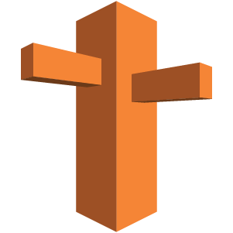
Amazon Route 53
Amazon Route 53
Notes:
Amazon Route 53 is a highly available and scalable cloud Domain Name System (DNS) web service. It is designed to give developers and businesses an extremely reliable and cost effective way to route end users to Internet applications by translating names like www.example.com into the numeric IP addresses like 192.0.2.1 that computers use to connect to each other. Amazon Route 53 is fully compliant with IPv6 as well.

Slide 7
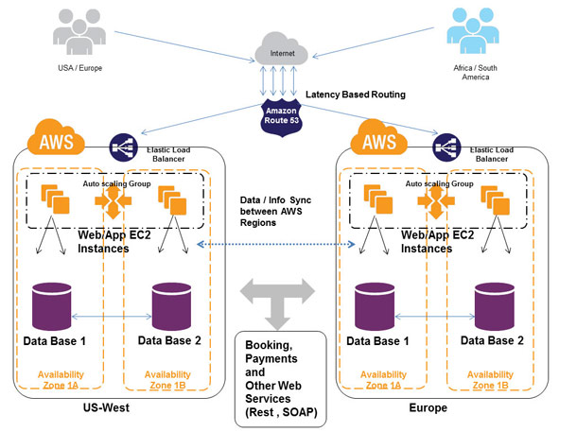
Amazon Route 53

Slide 8
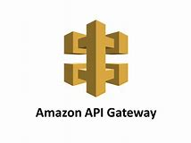
Amazon API Gateway
Notes:
Create, maintain, and secure APIs at any scale,
Amazon API Gateway is an Amazon Web Services (AWS) service offering that allows a developer to connect non-AWS applications to AWS back-end resources, such as servers or code. Amazon API Gateway allows an AWS customer to increase the overall utility of Amazon’s other cloud services.

Slide 9
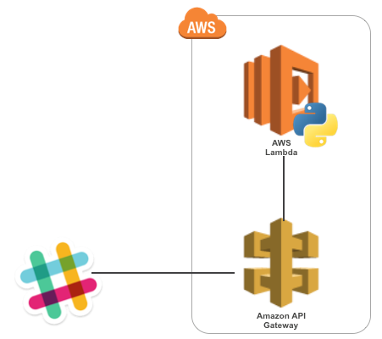
Amazon API Gateway

Slide 10
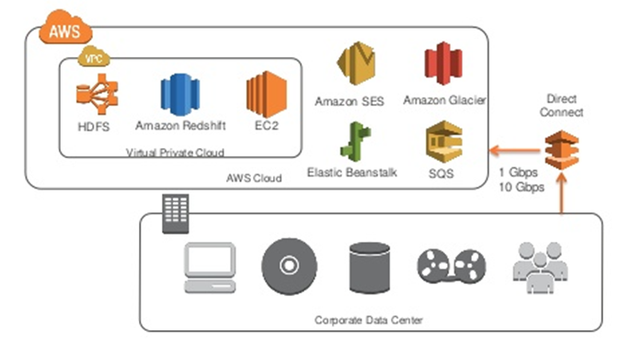
AWS Direct Connect
Using industry standard 802.1q VLANs
Notes:
AWS Direct Connect locations. Using industry standard 802.1q VLANs, this dedicated connection can be partitioned into multiple virtual interfaces.
Reduces Your Bandwidth Costs
If you have bandwidth-heavy workloads that you wish to run in AWS, AWS Direct Connect reduces your network costs into and out of AWS in two ways. First, by transferring data to and from AWS directly, you can reduce your bandwidth commitment to your Internet service provider. Second, all data transferred over your dedicated connection is charged at the reduced AWS Direct Connect data transfer rate rather than Internet data transfer rates.
Consistent Network Performance
Network latency over the Internet can vary given that the Internet is constantly changing how data gets from point A to B. With AWS Direct Connect, you choose the data that utilizes the dedicated connection and how that data is routed which can provide a more consistent network experience over Internet-based connections.
Compatible with all AWS Services
AWS Direct Connect is a network service, and works with all AWS services that are accessible over the Internet, such as Amazon Simple Storage Service (Amazon S3), Elastic Compute Cloud (Amazon EC2), and Amazon Virtual Private Cloud (Amazon VPC).
Private Connectivity to your Amazon VPC
You can use AWS Direct Connect to establish a private virtual interface from your on-premise network directly to your Amazon VPC, providing you with a private, high bandwidth network connection between your network and your VPC. With multiple virtual interfaces, you can even establish private connectivity to multiple VPCs while maintaining network isolation.
Elastic
AWS Direct Connect makes it easy to scale your connection to meet your needs. AWS Direct Connect provides 1 Gbps and 10 Gbps connections, and you can easily provision multiple connections if you need more capacity. You can also use AWS Direct Connect instead of establishing a VPN connection over the Internet to your Amazon VPC, avoiding the need to utilize VPN hardware that frequently can’t support data transfer rates above 4 Gbps.
Simple
You can sign up for AWS Direct Connect service quickly and easily using the AWS Management Console. The console provides a single view to efficiently manage all your connections and virtual interfaces. You can also download customized router templates for your networking equipment after configuring one or more virtual interfaces.

Slide 11
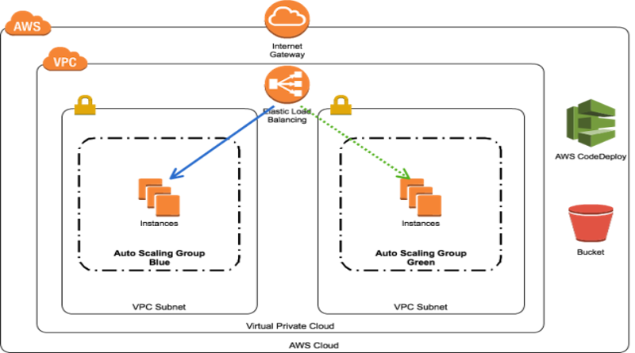
Elastic Load Balancing
Notes:
Achieve fault tolerance for any application by ensuring scalability, performance, and security.

Slide 12
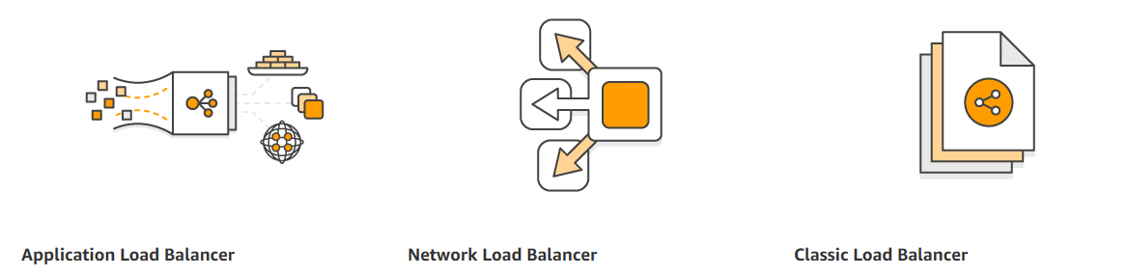
Elastic Load Balancing
Notes:
Layer 4 through Layer 7 are services delivered by the upper layers of the Open Systems Interconnection (OSI) communication model. Layer 4-7 services, sometimes referred to as the upper layers, support end-to-end communication between a source and destination application and are used whenever a message passes from or to a user.
Layer 4, the Transport Layer, ensures end-to-end delivery of messages for both "connection-mode" data such as TCP connections and "connectionless-mode" data such as UDP datagrams. For both modes, the endpoints of communication are identified by port numbers such as TCP port 80 or UDP port 161.
Layer 5, the Session Layer, provides services for coordinating communication between applications and synchronizing message delivery. For example, a protocol with suspend/resume or checkpoint/rollback capabilities includes session layerservices such as ITU X.225, AppleTalk or RPC.
Layer 6, the Presentation Layer, provides services for converting data from local format (abstract syntax) into a machine-independent format (transfer syntax). Many application protocols are defined in Abstract Syntax Notation One (ASN.1) notation. ASN.1 defines a set of data structures mapped to encoding rules – for example, how an Integer should be encoded into a bit string to be transmitted to and decoded by a recipient using XML Encoding Rules (XER).
Layer 7, the Application Layer provides common services used by applications to establish, release and abort communication with each other, as well as specific services. Most applications “live” at Layer 7, including the File Transfer Protocol (FTP), the Simple Mail Transfer Protocol (SMTP), the Post Office Protocol (POP), the Hyper Text Transfer Protocol (HTTP) and the Domain Name System Protocol (DNS).

